Slide 1

Problem :
Many students struggle to identify their true passions and align them with suitable career paths due to inadequate personalized guidance and resources. Traditional educational systems often fail to provide tailored support, and parental pressure can further complicate this, as parents may impose their career aspirations without considering their children's interests. This often leads students to pursue careers they dislike, resulting in disengagement and stagnation.
Rural students face additional challenges, including limited access to career counselors, mentorship opportunities, and exposure to diverse career options. Consequently, they may find themselves in unsatisfactory jobs that do not align with their strengths or passions.

Slide 2
Problem:
Lack of Personalized Guidance – Many students struggle to identify their passions due to inadequate career counseling and resources.
Flaws in Traditional Education – Schools often fail to provide tailored career support, leaving students without clear direction.
Parental Pressure – Parents may impose their career aspirations on children, leading to disengagement and dissatisfaction.
Rural Challenges – Limited access to career counselors, mentors, and exposure to diverse career options further restricts rural students.
Misaligned Career Choices – Many students end up in careers they dislike, resulting in lack of motivation and career stagnation.

Slide 3




Your
Personal
I ntro
MENTORA
Mentor

Slide 4

Solution:
AI-Powered Career Guidance – Helps students discover their passions and receive personalized career recommendations.
Interest-Based Tests – Evaluates students’ strengths and preferences to suggest suitable career paths.
Personalized Roadmaps – Provides step-by-step career plans tailored to individual aspirations.
Mentorship Opportunities – Connects students with professionals for real-world insights and guidance.
Parental Involvement – Encourages open discussions to align career choices with students' true interests.
Support for Rural Students – Bridges the gap for those with limited access to career counseling and mentorship.

Slide 5
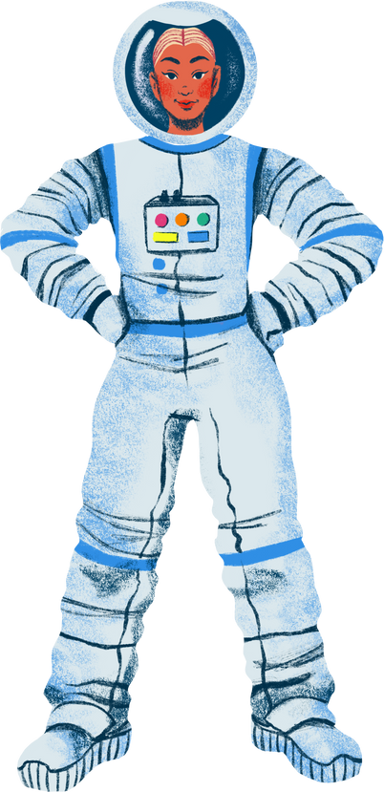
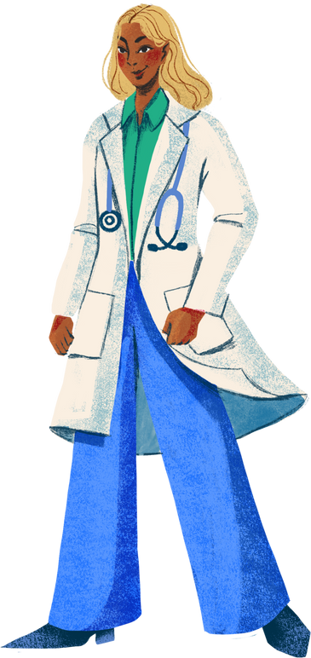

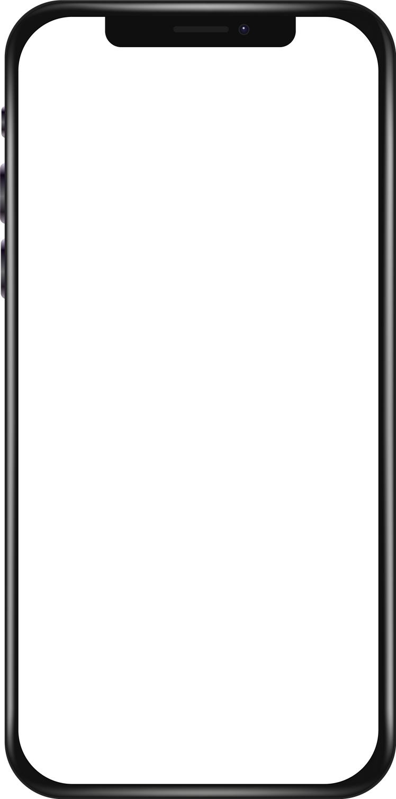


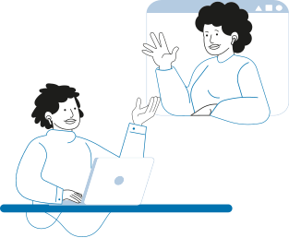


Flowchart
Takes a Passion-aligned profession test
Suggesting a career for you that aligns with your interests
Reveal my perfect profession
If you already know about your career goal or you want to explore careers and the outcome of your career, or check whether it aligns with your interests?
Also, you can contact people working in your dream career
Explore career options
My Journey
(My Planner)
This option provides you with a roadmap toward your dream career by providing you tasks that take you toward your goal, and you can check your progress here.
Provides you with free resources to upskill yourself

Slide 6
Mentora
Home
Explore
My Planner
Log In
Career advisor
Mentor Connect
Free Resources

Slide 7
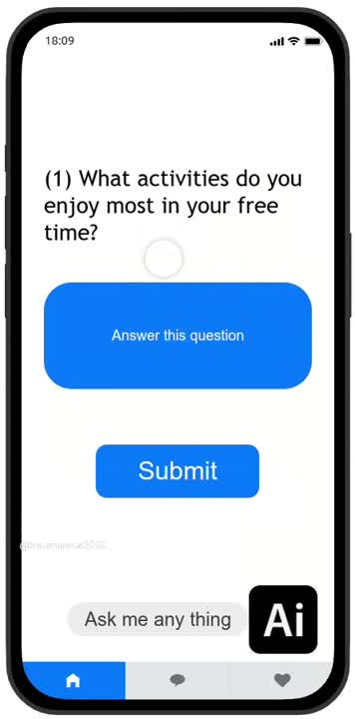
Takes a Passion-aligned profession test
Suggesting a career for you that aligns with your interests
If you already know about your career goal or you want to explore careers and the outcome of your career, or check whether it aligns with your interests?
Also, you can contact people working in your dream career
This option provides you with a roadmap toward your dream career by providing you tasks that take you toward your goal, and you can check your progress here.
Provides you with free resources to upskill yourself
Pls Play this video

Slide 8
TECHNICAL APPROACH
Backend Technologies :
RESTful APIs: Facilitate backend communication, managing user authentication, and storing call logs or settings.
Database Management Systems (e.g., MongoDB, PostgreSQL): For storing user data, call logs, and other relevant information.
1.Platform Architecture
Frontend Technologies :
WebRTC (Web Real-Time Communication): Enables peer-to-peer audio, video, and data sharing directly
JavaScript: Handles WebRTC APIs, manages video streams, and implements the logic for video calls.
HTML5: Creates the video elements and UI components necessary for displaying video streams.
CSS: Styles the video call interface and layouts for a user-friendly experience.
React/Vue/Angular: Frameworks or libraries to build UI components for video calls and manage user interactions.
2. Key Features
Video Call Integration: WebRTC for real-time video communication.
Chat Functionality: Socket.io for real-time chat during sessions.
Calendar Integration: Sync with Google Calendar for appointment reminders.
3
Notes:
3

Slide 9
IMPACT AND BENEFITS
Personalized Career Guidance: Video calls provide students with tailored, one-on-one sessions with career counselors, helping them identify career paths aligned with their interests and strengths.
Direct Access to Industry Experts: Students can interact with professionals working in their dream careers, gaining real-world insights and advice on how to pursue their desired fields.
Increased Opportunities for Rural and Remote Students: Video calling breaks down geographic barriers, allowing students in underserved areas to access the same career guidance and mentorship as their urban counterparts.
Informed Career Exploration: By engaging in conversations with mentors and professionals, students can explore diverse career options, make better-informed decisions, and avoid pursuing paths that don’t align with their passions.
Notes:
5

Slide 10
RESEARCH AND REFERENCES
RESEARCH:
Integrated AI into education can improve personalized learning and career guidance,addressing gaps for students in underserved areas.
Career counseling significantly impacts students choice and satisfaction, reducing dropout rates and improve employment outcomes.
References:
Books on Mentorship and career development.
Personalized career guidance with AI.
Mentorshipin rural areas which impact on career growth.
Online courses: Coursera/Udemy/Youtube.
6
Notes:
6

